Slide 1
HIRING PROCESS ANALYTICS
ANSU M CHIRAYIL
Hyperlink to the Excel Sheet: https://docs.google.com/spreadsheets/d/1kCqm5IzEXVB3PAccTbiwwZ1dJEowPz_g/edit?usp=sharing&ouid=102355042022057054818&rtpof=true&sd=true

Slide 2
PROJECT DESCRIPTION
Analyze the hiring process data of a multinational company like Google to extract meaningful insights that can optimize the hiring process.
Identify and understand trends related to the number of rejections, interviews, job types, and vacancies to provide valuable insights to the hiring department.
Utilize the dataset provided containing records of previous hires to conduct the analysis.
Answer the key questions using statistics and Excel to draw meaningful conclusions that could help the company improve its hiring process and make better hiring decisions in the future.

Slide 3
APPROACH
Data Preparation: Download the dataset, handle missing data, and club similar categories for simplified analysis. Detect and manage outliers appropriately.
Analysis Tasks: Use Excel to analyze gender distribution in hires, calculate average salary, understand salary distribution, and visualize department and position tier data using charts.
Data Summary: Summarize findings using statistical measures and visualizations to highlight key insights from the hiring process data.
Report Creation: Compile a concise report with analysis results, visualizations, and recommendations to improve the company’s hiring process.

Slide 4
TECH-STACK USED
Microsoft Excel 2021
It is a powerful spreadsheet program used for data analysis, organizing information, performing calculations, and creating visualizations. It's commonly used for tasks such as budgeting, financial modeling, data analysis, and managing large datasets.
Excel offers features like formulas, pivot tables, and charts, making it a versatile tool for both personal and professional use.

Slide 5
DATASET OVERVIEW
The dataset contains records of candidates who were interviewed previously with information about hiring status, hiring department, salary etc.
Dataset details:
Number of data points – 7168
Number of features – 6
Column details –
application_id – ID of the applicant
Interview Taken on – Date and time of the interview
Status – Hired or Rejected
event_name – gender of the applicant
Department – name of the department
Post name – name of the post offered
Offered salary – salary offered for the job

Slide 6
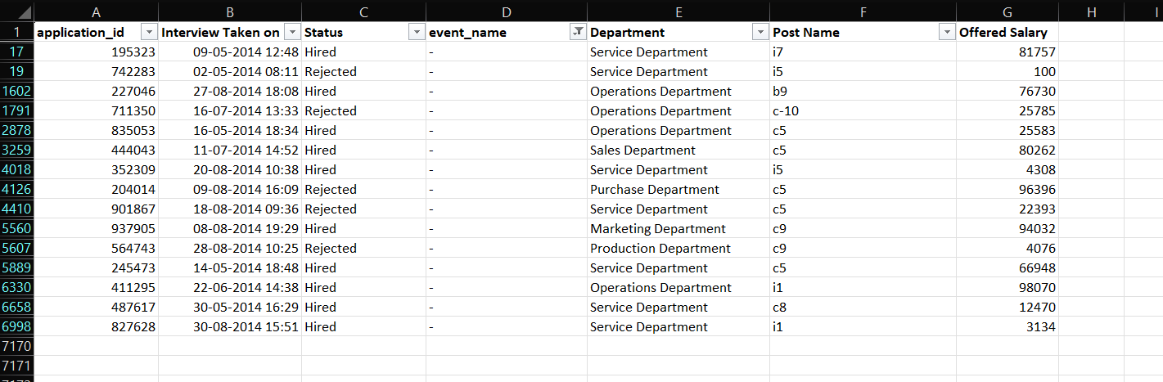
DATA PRE-PROCESSING
Handle Missing Values
Column event_name has some rows with ‘-’ as it’s values. We replaced those missing values to “Don’t want to say” as they both indicate the same meaning.

Slide 7
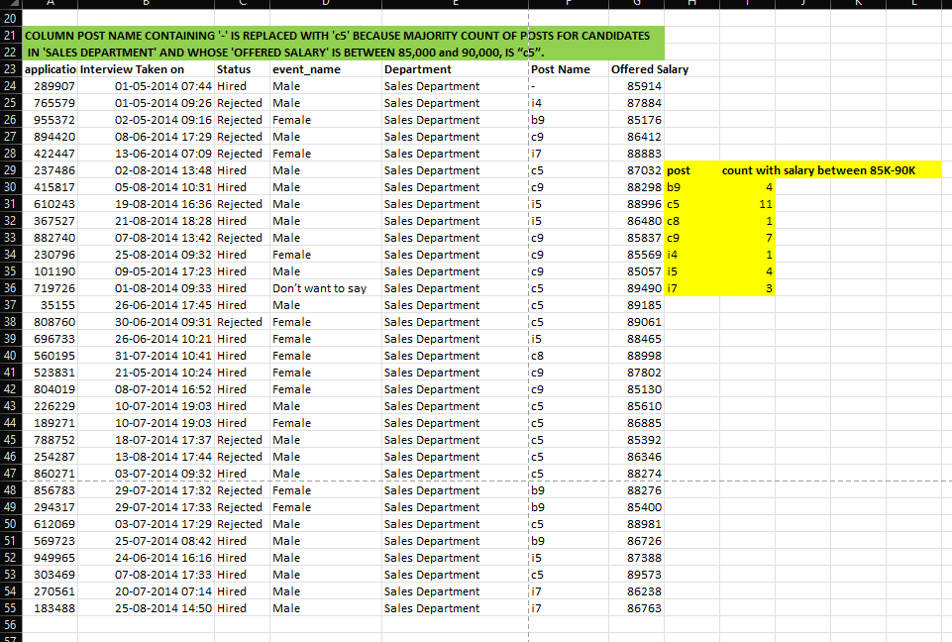
DATA PRE-PROCESSING
Handle Missing Values
Column post name containing '-' is replaced with 'c5' because majority count of posts for candidates in 'sales department' and whose 'offered salary' is between 85,000 and 90,000, is ‘c5’.

Slide 8
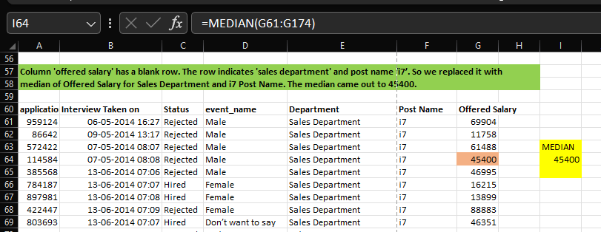
DATA PRE-PROCESSING
Handle Missing Values
Column offered salary has a blank row. The row indicates 'sales department' and post name ‘i7’. So we replaced it with median of Offered Salary for Sales Department and i7 Post Name. The median came out to 45400.

Slide 9
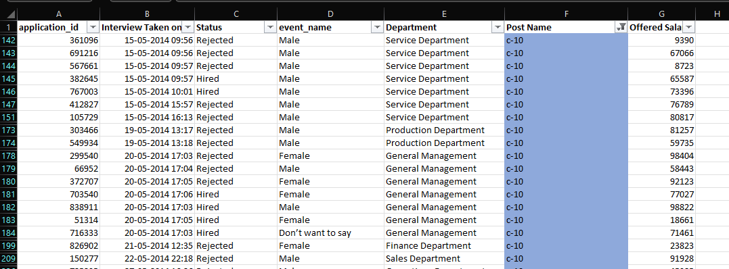
DATA PRE-PROCESSING
Rectifying errors
Column Post Name has a category “c-10” which seems to be a typo and the correct category should be “c10” which is replaced.

Slide 10
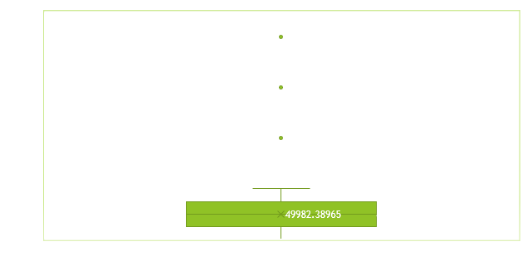
DATA PRE-PROCESSING
Detecting Outliers
From the below Box Plot of Column Offered Salary, there are three rows whose Column values are outliers and the values are 200000, 300000, 400000.

Slide 11
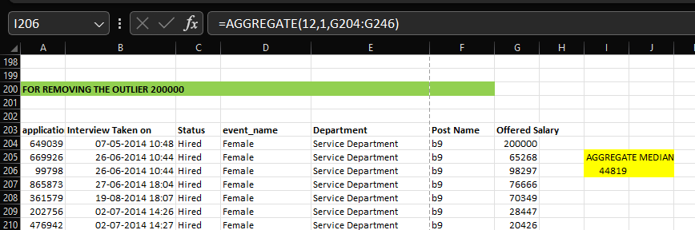
DATA PRE-PROCESSING
Replacing Outliers
Replace the outliers with median value of Offered Salary for corresponding Department and Post Name.
For Offered salary 200000

Slide 12
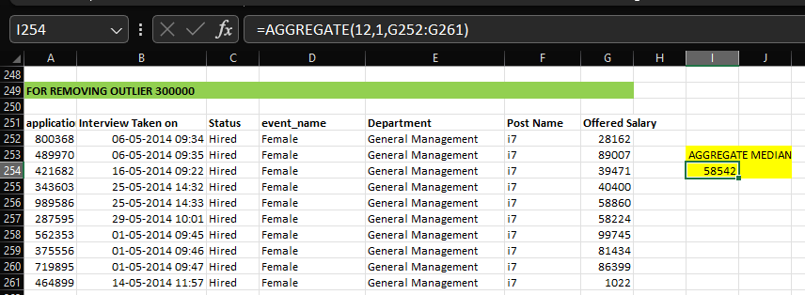
DATA PRE-PROCESSING
Replacing Outliers
Replace the outliers with median value of Offered Salary for corresponding Department and Post Name.
For Offered salary 300000

Slide 13
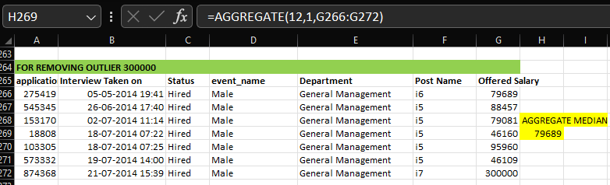
DATA PRE-PROCESSING
Replacing Outliers
Replace the outliers with median value of Offered Salary for corresponding Department and Post Name.
For Offered salary 400000

Slide 14
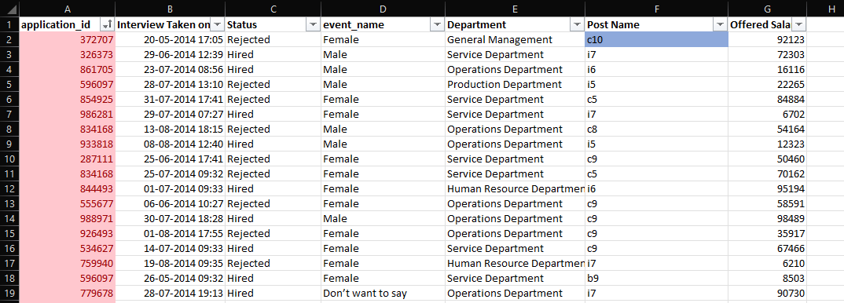
DATA PRE-PROCESSING
Identifying duplicate values
Column application_id has 54 rows with duplicate values. Using conditional formatting, we highlighted the duplicate values with light red fill.

Slide 15
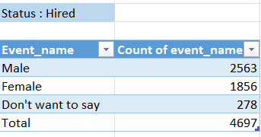
DATA ANALYTICS TASKS
A. Hiring Analysis: The hiring process involves bringing new individuals into the organization for various roles. Determine the gender distribution of hires. How many males and females have been hired by the company?
INSIGHTS
Males constitute the majority of hires at 55%, indicating a male-dominated hiring trend.
Females make up 39% of the hires, suggesting the company is making efforts towards gender diversity but still has a significant gap
A small percentage (6%) chose not to disclose their gender, reflecting some inclusivity in the hiring process.
These insights suggest that while there is a noticeable effort towards diversity, there may still be room for improvement in balancing gender representation among hires.

Slide 16
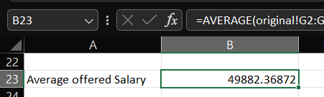
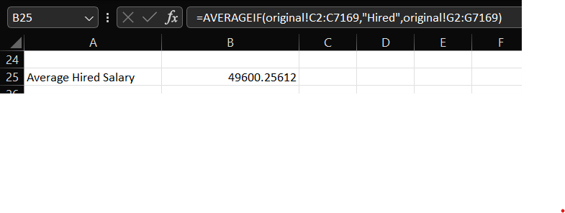
DATA ANALYTICS TASKS
B. Salary Analysis: The average salary is calculated by adding up the salaries of a group of employees and then dividing the total by the number of employees. Use Excel functions to calculate the average salary offered by this company?
INSIGHTS
The Average Offered Salary is Currency-Unit 49882.36872 and the Average Salary of Hired Candidates is Currency-Unit 49600.25612.
The Average Salary of Hired Candidates is almost same as that of Offered Salary. This shows that the hiring team is recruiting candidates as per the pre-determined salary bands of the organization.

Slide 17
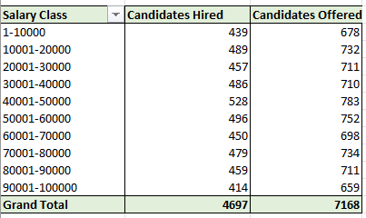
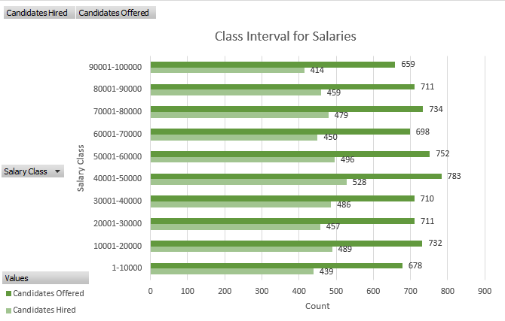
DATA ANALYTICS TASKS
C. Salary Distribution: Class intervals represent ranges of values, in this case, salary ranges. The class interval is the difference between the upper and lower limits of a class. Create class intervals for the salaries in the company.

Slide 18
DATA ANALYTICS TASKS
C. Salary Distribution: Class intervals represent ranges of values, in this case, salary ranges. The class interval is the difference between the upper and lower limits of a class. Create class intervals for the salaries in the company.
INSIGHTS
Salary Class with the Highest Offers: The salary range of 40,001 - 50,000 has the highest number of candidates offered, with 783 offers. This indicates that this salary class is the most attractive job roles being offered.
Lower Salary Classes: The lowest salary range (1 - 10,000) has significantly fewer candidates hired (439) and offered (678) compared to higher salary ranges. This may indicate a preference for higher salary positions among candidates or fewer job openings in this range.
Balanced Hiring in Mid-Range Salaries: Salary classes between 50,001 - 80,000 show a relatively balanced number of candidates hired and offered, indicating stable recruitment dynamics in these salary ranges.
These insights can help the organization understand salary preferences among candidates and optimize their hiring strategies to align with market expectations.

Slide 19
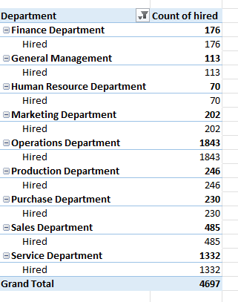
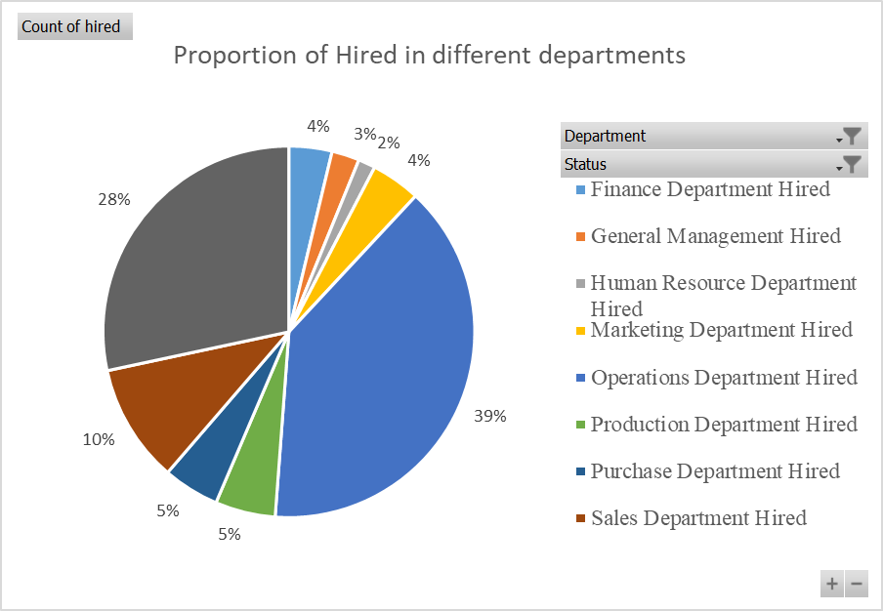
DATA ANALYTICS TASKS
D. Departmental Analysis: Visualizing data through charts and plots is a crucial part of data analysis. Use a pie chart, bar graph, or any other suitable visualization to show the proportion of people working in different departments.

Slide 20
DATA ANALYTICS TASKS
D. Departmental Analysis: Visualizing data through charts and plots is a crucial part of data analysis. Use a pie chart, bar graph, or any other suitable visualization to show the proportion of people working in different departments.
INSIGHTS
Finance Department Focus: The Finance Department has the highest proportion of hires at 39%, indicating a strong focus on financial roles.
Significant HR Hiring: 29% of hires are in the Human Resource Department, suggesting a priority on expanding or strengthening HR functions.
Moderate Sales Hiring: The Sales Department accounts for 10% of hires, reflecting steady hiring needs in sales.
Limited Hiring in Other Departments: Departments like General Management, Marketing, Operations, and others each have around 5% of hires, indicating balanced but less aggressive hiring in these areas.

Slide 21
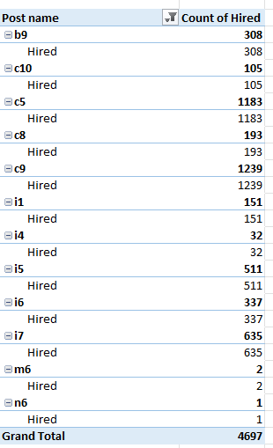
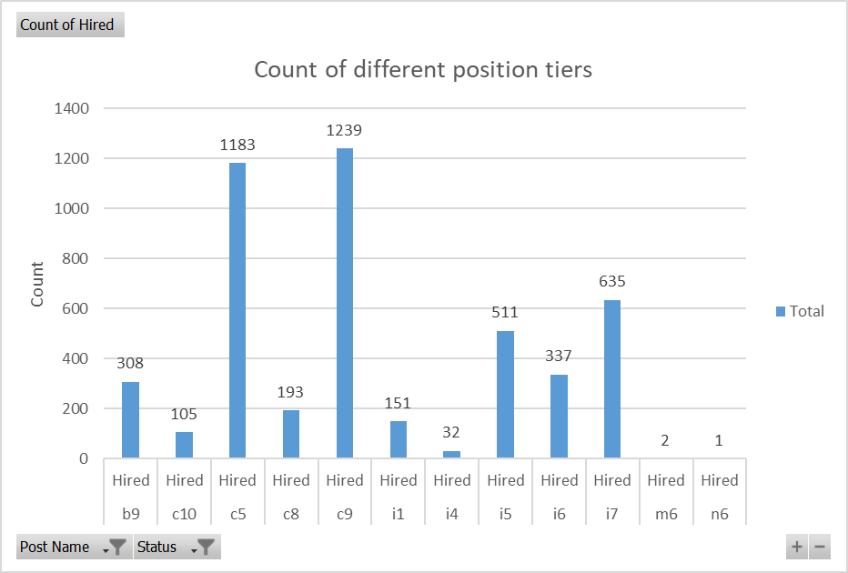
DATA ANALYTICS TASKS
E. Position Tier Analysis: Different positions within a company often have different tiers or levels. Use a chart or graph to represent the different position tiers within the company.

Slide 22
DATA ANALYTICS TASKS
E. Position Tier Analysis: Different positions within a company often have different tiers or levels. Use a chart or graph to represent the different position tiers within the company.
INSIGHTS
Highest Hiring for Posts c9 and c5: Post c9 has the highest number of hires at 1,239, followed closely by Post c5 with 1,183 hires. These two posts together account for over 50% of total hires.
Moderate Hiring for Post i7: Post i7 also shows a significant number of hires at 635, indicating strong hiring activity for this position.
Low Hiring in Posts m6 and n6: Posts m6 and n6 have the lowest hiring numbers, with just 2 and 1 hire(s) respectively, suggesting very limited or specialized needs for these roles.

Slide 23
RESULT
Missing values were detected in the dataset and were handled by replacing numerical data with the mean and categorical data with the mode.
Columns with similar categories were combined to reduce complexity and improve data analysis, allowing for a more straightforward interpretation of the data.
Outliers were identified in the salary data, and a strategy was implemented to manage them, ensuring they did not skew the results significantly.

Slide 24
RESULT
Gender distribution analysis revealed the total number of male and female hires, providing insights into hiring patterns and potential gender biases.
The average salary offered by the company was calculated using Excel functions, giving a clear picture of the company's compensation structure.
Salary distribution was visualized using class intervals, highlighting how salaries are spread across different ranges within the company.
Departmental and position tier analysis was visualized through charts, revealing the distribution of employees across various departments and tiers, which helped identify areas with more or fewer hires.

Slide 25
THANK YOU

